Slide 1



ADVANCED PROGRAM IN AI – POWERED MARKETING
AI-Based MROI Optimization for Tally
Capstone Project
Cohort 2, Group 9
Mentor
Kumar Gyanam
Prof. Saravana J.
Meera Raman
Prathamesh Desai
Somya Tripathi

Slide 2


About
Tally Solutions Pvt. Ltd.
Offers services like ERP implementation, Training on product usage, Deployment, Software assurance, Data migration, Business advisory, and Integration.
.Incorporated in late 1991 - India's leading business management
software product company.
Imports & exports computer software programs for use in Industries, Banks, Financial Institutions, Hotels and other Commercial establishments.
Offers custom built, business specific, country specific solutions, data migration tools, device integrations, 3rd party integration, and add-ons.
Offers a wide range of products: Tally Prime, Tally Primer Server & Shopper 9.
Ticket size: Rs. 600/month - Rs. 54,000/perpetual

Slide 3
Data Variables
Audience
Behavior
Client ID
User Type
Gender
Age
In-Market Segment
Browser
Device Category
Bounce Rate
Page/Session
Avg. Session Duration
Time on Page
Unique Page Views
Page Load Time ms
Page Download Time ms
Google Analytics Data
Acquisition
Conversion
Source
Medium
Channel
Sessions
% New Sessions
Referrals
Avg. Document Content Loaded Time sec
Goal Completions
Goal Conversion Rate
Avg. Order Value
Transactions
Revenue
Ecommerce Conversion Rate
12/10/20-19/10/21

Slide 4
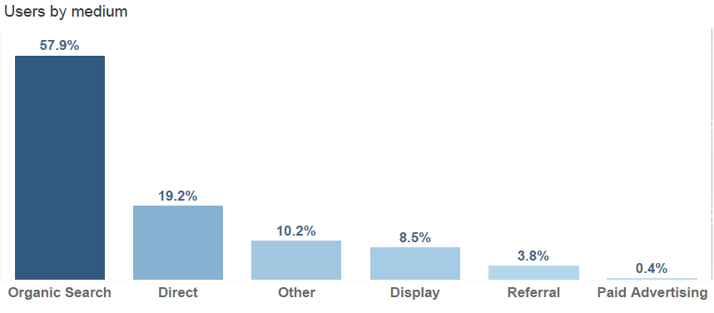
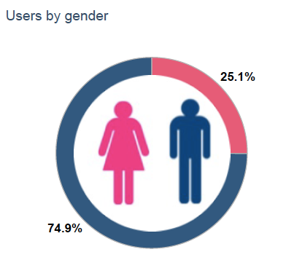
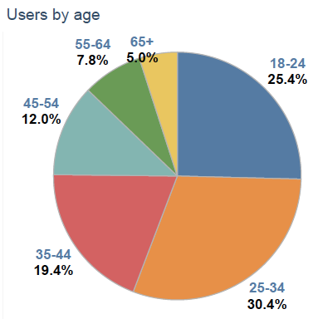
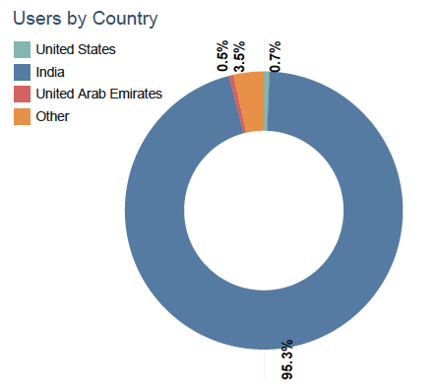
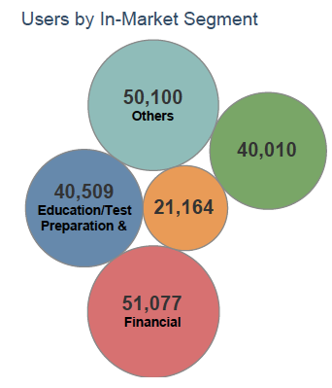
AUDIENCE CHARACTERISTICS

Slide 5
Project Objectives
To effectively predict the likelihood of conversion of website users.
Objective 1
To effectively predict the potential amount of revenue generation by a converted user.
Objective 2
To predict the propensity score for a lead for more effective marketing and sales conversions.
Objective 3

Slide 6
Objective 1
Website User Conversion Prediction

Slide 7



Model Building Process
Data Cleaning
Data Balancing
Model Running
Model Selection
Output
- No Missing Data
- Removal of Zero & Near Zero-Variance Predictors
- Removal of highly correlated Predictors
- Removal of Predictors rejected by Boruta
- ROSE package for over sampling, under sampling and both sampling for imbalanced data (high number of zeros).
- UBL package for balancing with SMOTE
- We use all balancing techniques to check for higher accuracy.
- Random Forest
- SVM (Limited to Under Sample due to limited computational power)
- Logistic Regression
- XGBoost (Highest Performance & Speed)
- Based on accuracy parameters, Random Forest with under sampled data (RF UNDER) is selected for hyperparameter tuning
- XGBOOST is then used to find if performance is further
- All models have high AUC and accuracy, but XGBOOST is tuned because:
# It has the highest number of True Positives - better accuracy rates means faster closures.
# Higher False Positives means a sizeable population to re-target.
Notes:
Always Be Prioritizing Don't fall victim to "check-list" marketing. That is, don't feel compelled to create a giant list of all the marketing activities you can possibly execute. Hold on to the focus you established with your Big Goal and Growth Plan. Pick the 3 most important aspects of your marketing plan that will drive 80% of your results. Position these as your big levers. You will not be derailed from making them a success.

Slide 8
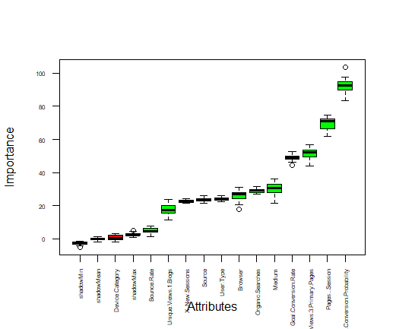

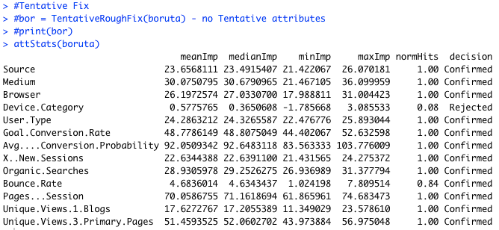
Boruta Output
Attribute below shadowmax are rejected.

Slide 9
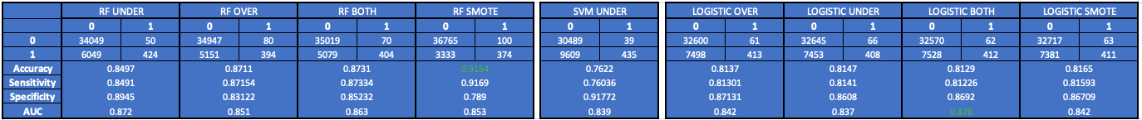

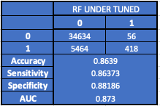
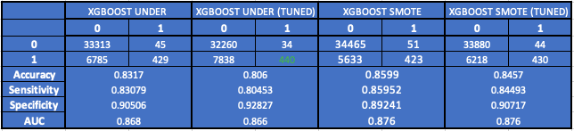

Prediction Models
Fairly high AUC
Higher True Positives: Better accuracy rate, faster closure
Higher False Positives: A sizeable population to target

Slide 10







Significant Attributes
1
Pages/Session
2
Unique Views - 3 Primary (Product) Page
3
Goal Conversion Rate
4
Bounce Rate

Slide 11
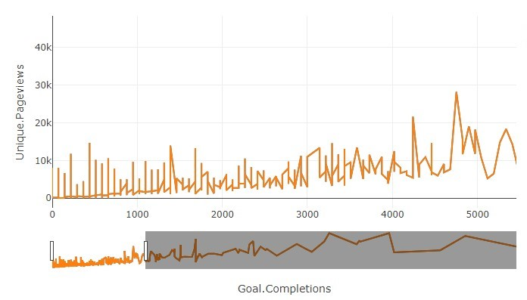
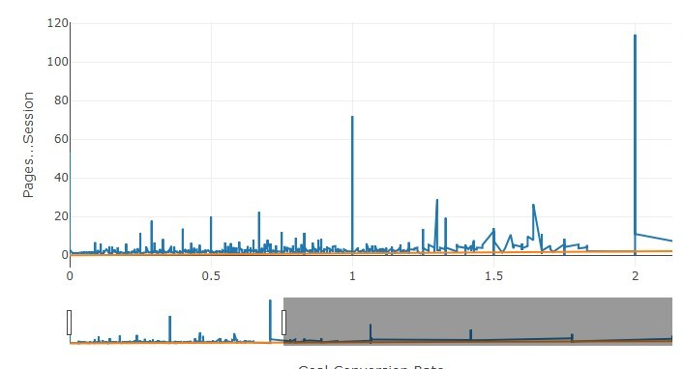
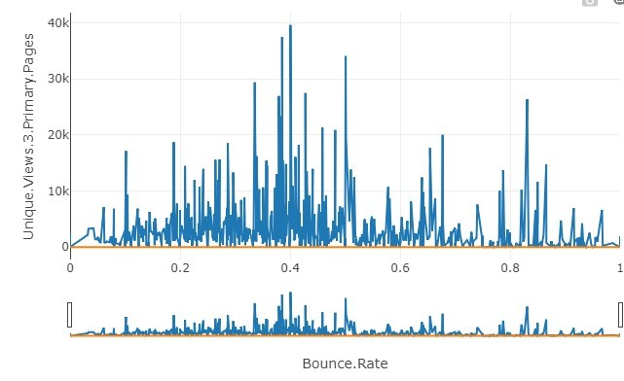
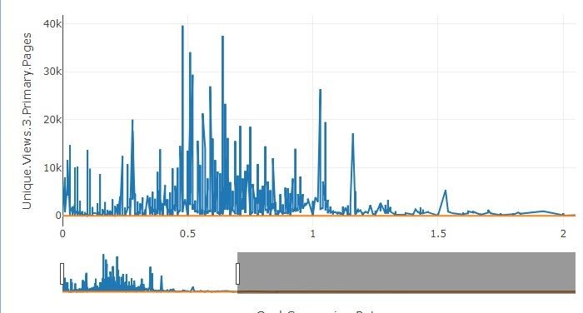
Conversion Visualization
- Page views and sessions taper after a point
-This means that those who do not convert in the first instance, lose their way through the journey
- NEED – more engaging content to minimize drop off. Better UX
PRODUCT PAGES UNIQUE VIEW VS GOAL CONVERSION
PAGE SESSION VS GOAL CONVERSION
PRODUCT PAGES UNIQUE VIEW VS BOUNCE RATE
UNIQUE PAGE VIEW VS GOAL COMPLETION

Slide 12
Objective 2
Potential Customer Revenue Generation Prediction

Slide 13




Model Building & Selection Process
Data Cleaning
Model Running
Model Selection
Output
- No Missing Data
- Removal of Zero & Near Zero-Variance Predictors
- Removal of highly correlated Predictors
- Removal of Predictors rejected by Boruta
- Random Forest
- SVM
- Linear Regression
- Based on lowest RMSE, Random Forest is selected.
- Random Forest model is tuned for hyperparameters
- Tuned Random Forest model has the lowest RMSE, thus is the selected model.
- mtry=13; ntree=1078; nodesize=17
Lowest RMSE (in Rs.)
Notes:
Always Be Prioritizing Don't fall victim to "check-list" marketing. That is, don't feel compelled to create a giant list of all the marketing activities you can possibly execute. Hold on to the focus you established with your Big Goal and Growth Plan. Pick the 3 most important aspects of your marketing plan that will drive 80% of your results. Position these as your big levers. You will not be derailed from making them a success.

Slide 14

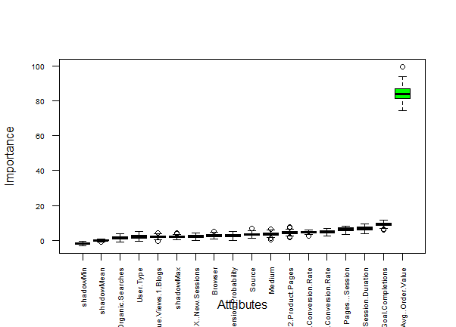
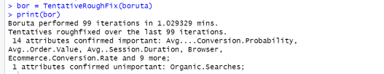
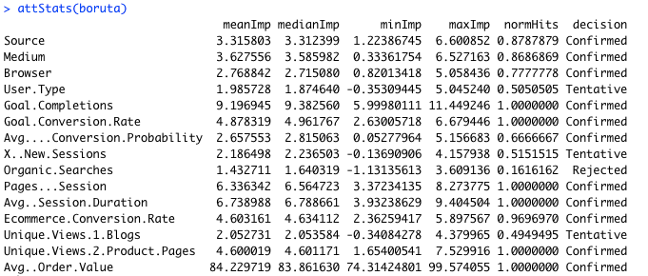
Boruta Output
Attributes below shadowmax are rejected.

Slide 15
Significant Attributes
1
Avg. Order Value
2
Avg. Session Duration
3
Goal Completions
4
Ecommerce Conversion Rate

Slide 16
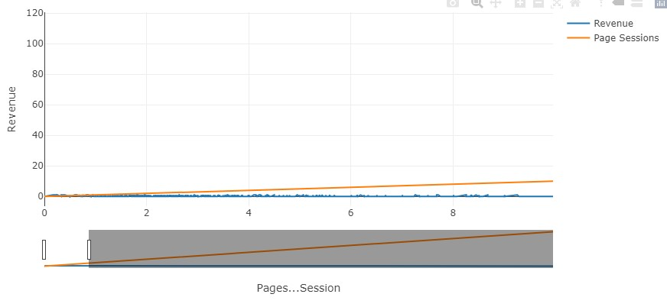
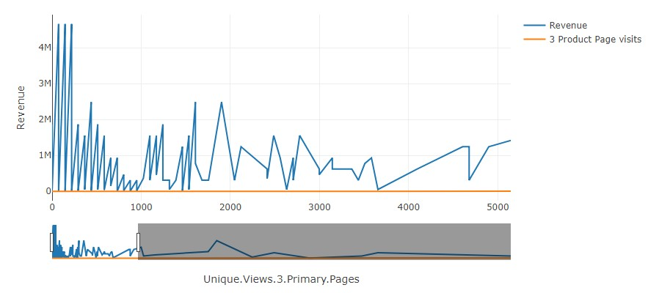
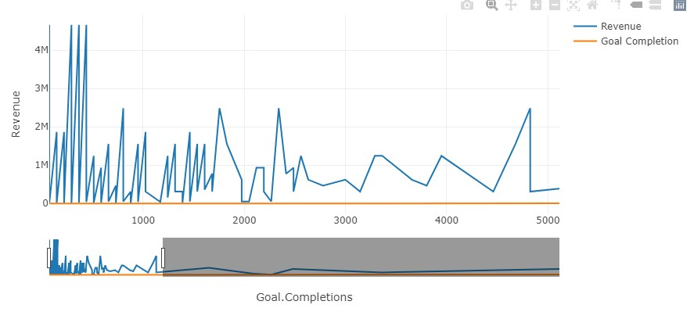
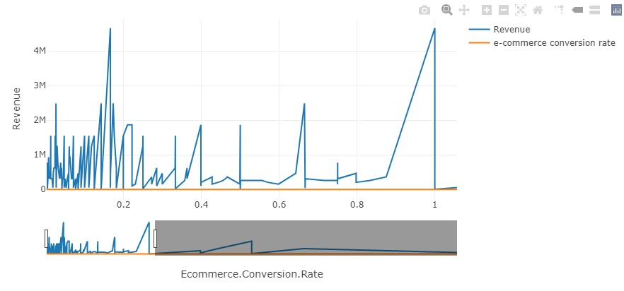
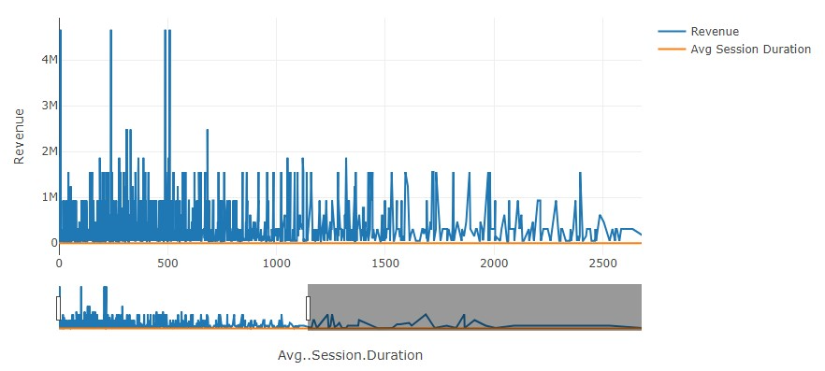
REVENUE VS PAGE SESSIONS
REVENUE VS UNIQUE PAGE VIEWS (PRODUCT PAGE)
REVENUE VS GOAL CONVERSION RATE
Observation: Revenue is consistent up to a particular point, after which it becomes erratic and sparse.
REVENUE VS GOAL COMPLETION
REVENUE VS ECOMMERCE CONVERSION RATE
REVENUE VS AVERAGE SESSION DURATION

Slide 17
Objective 3
Lead Propensity Scoring for Improved MROI

Slide 18
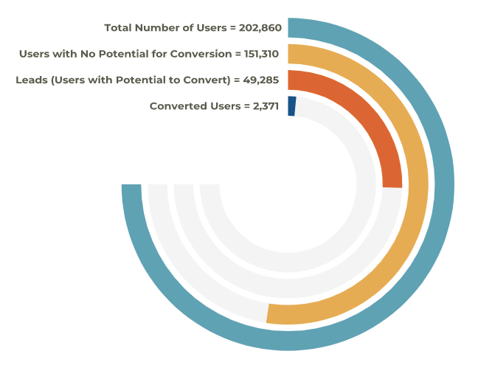
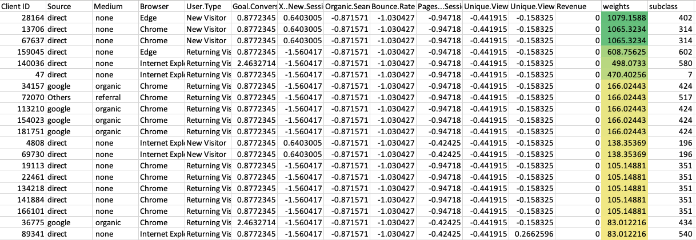
HOT LEADS
Lead Propensity Scoring using Greedy Matching
User Data Breakdown
WARM LEADS
SAMPLE
Data Snapshot
COLD LEADS

Slide 19
Recommendations

Slide 20


Tally Web Analysis
Keywords Identification and Inclusion
SEO Friendly Navigation
Correct and Compelling Content
Improve UX
https://tallysolutions.com/
7
9
8
6
https://tallysolutions.com/tally-prime/
7
9
9
6
https://tallysolutions.com/tally-prime-server/
7
9
9
6
https://tallysolutions.com/tally-shoper-9/
7
9
9
6
https://tallysolutions.com/download/
2
2
2
5
https://tallysolutions.com/buy-tally/
NA
9
6
8

Slide 21
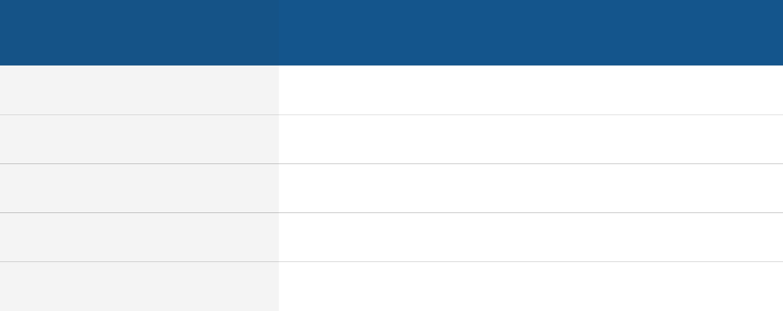



MROI Optimization
IMPACT OF RECOMMENDATIONS
Attributes
Propensity Outcomes
Recommendation
Unique Views - 3 Primary (Product) Page
Goal Conversion Rate
Bounce Rate
Avg. Order Value
Goal Completions
Pages Per Session
Avg. Session Duration
Ecommerce Conversion Rate
Cold Leads
Warm Leads
Hot Leads
Drip email campaigns for all 3 products consisting of interlinked, personalised, gated content that provides fresh information for continuous engagement and conversions in terms of form fills.
Enhanced, interactive and personalised user journey experience on the website through constantly fresh, dynamic, optimised and relevant content for all 3 products, including testimonials, use cases and videos.
Improve SEO score through keywords optimization and quality backlinks from reputable publications via PR activities.
Value offers and discounts for increased conversion potential and higher order value, especially for subscription plans.
Direct Connect via Outbound Calling by Pre-sales team.

Slide 22
Thank You

